Slide 1
SKIN DISEASE PREDICTION
USING AI AND ML
M.DHARANI
AishwarYA SURESH
G.LIKHITHA

Slide 2
AGENDA:
INTRODUCTION
MODEL OVERVIEW
ARCHITECTURE OF MODEL
SKIN DISEASES PREDICTED
RESULT
ADVANTAGES
DISADVANTAGES
APPLICATIONS
FUTURE WORKS

Slide 3
INTRODUCTION
Skin diseases had the fourth leading cause of nonfatal disease
Skin diseases caused enormous economic burdens
The identification of skin disease from dermoscopy images are treated as an image classification problem.
The convolutional neural network (CNN) binds the feature extraction, feature selection and classification modules into a single unit.

Slide 4
MODEL OVERVIEW
An automated image based system
Our approach requires a camera and a computer.
Skin images are filtered to remove unwanted noise and also process it for enhancement of the image.
Feature extraction using complex techniques
Soft max classifier
This system will give more accuracy and will generate results faster than the traditional method.

Slide 5
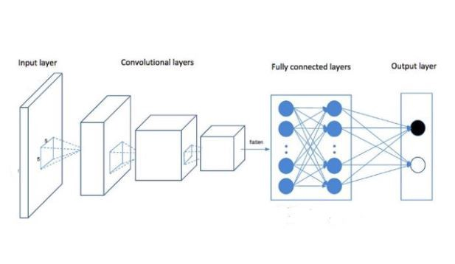
ARCHITECTURE OF MODEL

Slide 6
SKIN DISEASES PREDICTED
Acne
Psoriasis
Malignant Cancer
Rosacea
Vitiligo

Slide 7
RESULT:
Our CNN model has been applied with two convolution layers and four hidden layers.
This model predicts following skin diseases :
Acne, Melanoma, psoriasis, Rosacea, Vitiligo.
Accuracy : 75.8 %
Flask application in front end
HTML as bridge to launch the model through local host

Slide 8
ADVANTAGES:
Acute prediction
User friendly
Disease Analysis from home
Awareness
Suggestions
First aid
Time Saving

Slide 9
DISADVANTAGES :
Privacy and Security
New challenges every day
Massive Data Sets
Efficient Algorithm
Skin Tone
Financial Problems

Slide 10
APPLICATIONS:
Deep learning algorithms
Predictions are easy!!
Diagnosis
Preliminary skin diseases prediction

Slide 11
FUTURE WORKS :
Many other diseases can be predicted
Software Development
Hardware Development
Rapid Diagnosis treatment

Slide 12


